Slide 1
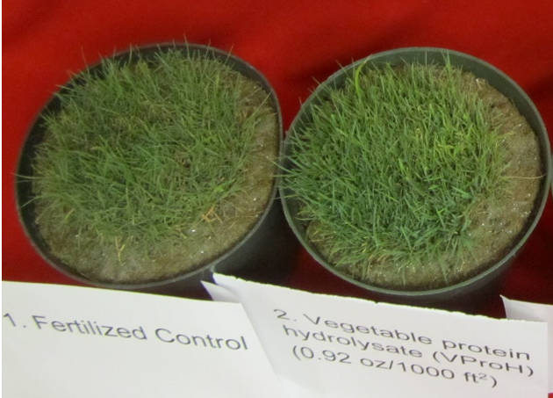
Amino Acid – Virginia Tech 2017
Improved visual color/quality
Photo at 56 days

Slide 2
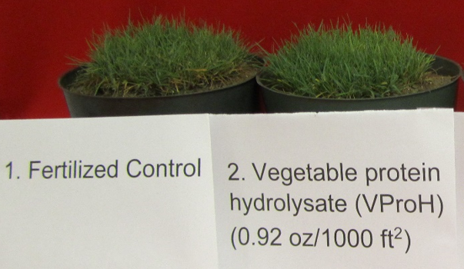
Amino Acid – Virginia Tech 2017
Improved visual color/quality
Photo at 56 days

Slide 3
a
+71%
ab
b
b

Slide 4
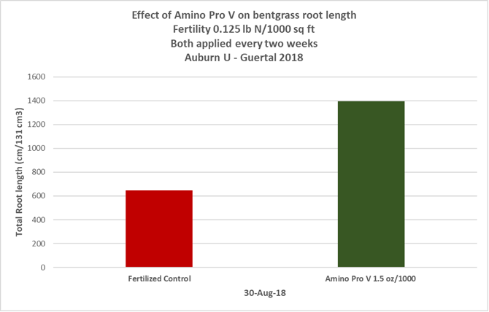
Amino Acid – Auburn U 2018
Improved Root Growth

Slide 5
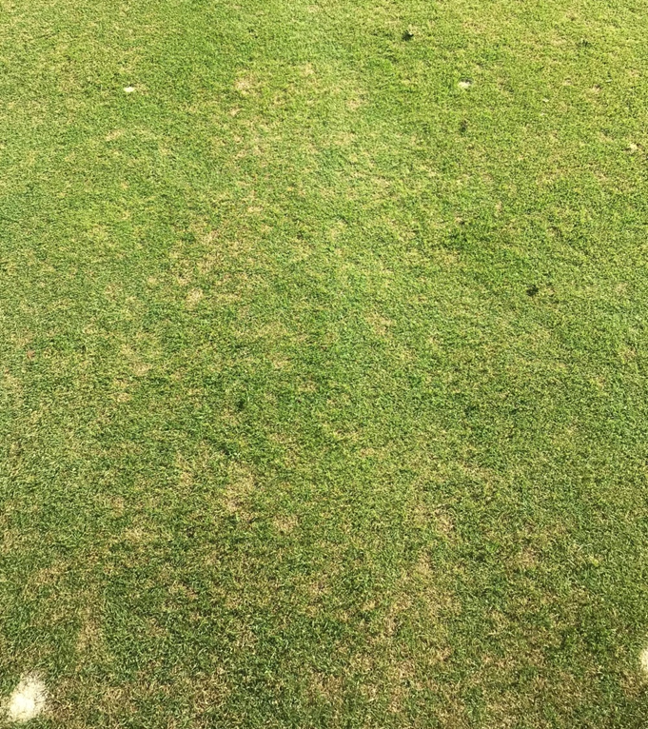
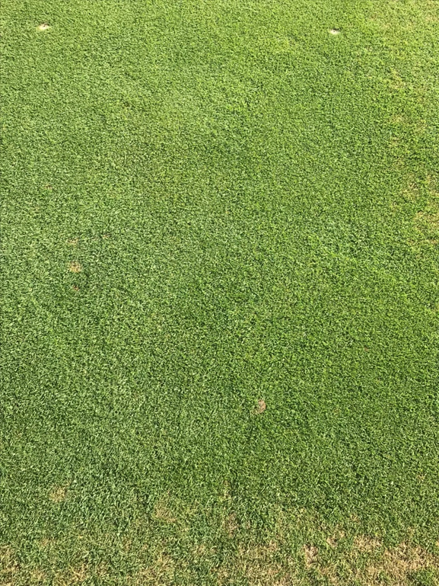
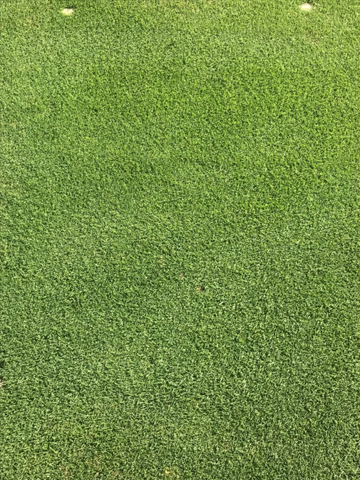
Rutgers – Amino Acid 2017
Untreated
Fungicide Alone
Base Program #30
Includes Fungicide + AA

